Slide 1
WATER POLLUTION
Introduction of water pollution
2. Sources of water pollution
3. Side effects of water pollution

Slide 2
WATER POLLUTION
Water Pollution can be defined as alteration in physical , chemical or biological characteristics of water which causes unsuitability and harm to environment .
Fresh Water consist of 4% on earth surface so it should be used with care and do not waste it .

Slide 3
SOURCES OF WATER POLLUTION
Sources of Water Pollution are as follows :
1. Municipal Waste water
2.Inorganic Pollutants
3.Organic Pollutants
4.Agricultural Waste
5.Thermal Waste

Slide 4
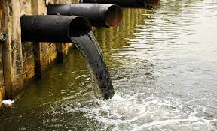

Slide 5
SIDE EFFECTS OF WATER POLLUTION
It contaminates the food chain and also imbalances the cycle.
Lack of portable water causes effects on wild animals.
Also contaminated water causes lack of diseases.

Slide 6
CONCLUSION
In conclusion , drinking water is a very important thing to our bodies health .
Not only human but also all of the organism need water to survive .
Don’t waste water unnecessarily and try to use water in effective way .

Slide 7
THANK YOU

